Slide 1
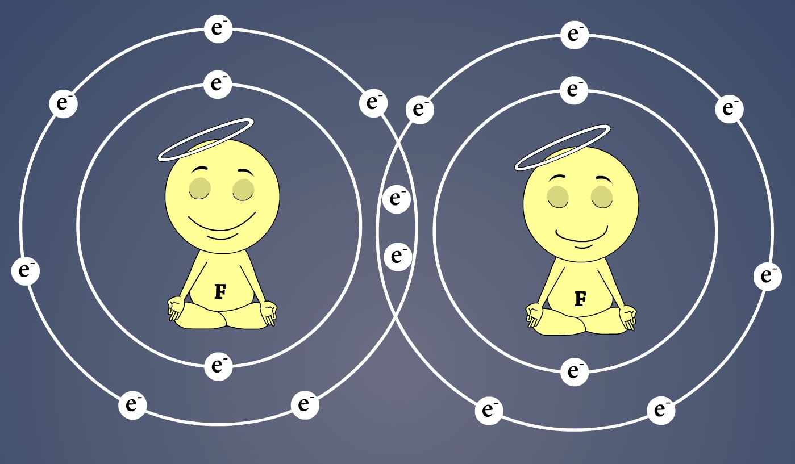
Lecture 8-9: Chemical Bonding – Homonuclear Diatomic Molecules

Slide 2
Valence Bond and Molecular Orbital Approaches
Valence Bond Theory
Extension of Lewis electron dot model
Overlap of atomic orbitals and sharing of electron pairs
Works fine for many systems
Limited to two center two electron bonds
Delocalization: Resonance
Cannot describe excited states
Molecular Orbital Theory
Electron(s) moving in the joint field of nuclei
Set up the Hamiltonian: Exactly solvable for H₂⁺ but not for more complex molecules
Molecular orbitals: Linear combination of Atomic Orbitals (LCAO)
Can handle delocalization, excited states. A general theory
A bit too general at times (ionic structure for H₂, for example)

Slide 3
Bonding: H₂⁺ and H₂ molecules
-
e⁻
r_{A}
r_{B}
atom
r
+
+
R
H_{A}
H_{B}

Slide 4
Bonding: H₂⁺ and H₂ molecules
-
e⁻
r_{A}
r_{B}
r
+
+
R
H_{A}
H_{B}
-
e⁻
r_{1A}
r_{1B}
r₁
H_{A}
+
+
H_{B}
r₂
R
r_{2A}
r_{2B}
e⁻
-

Slide 5
Bonding: H₂⁺ and H₂ molecules
-
e⁻
r_{A}
r_{B}
r
+
+
R
H_{A}
H_{B}
-
e⁻
r_{1A}
r_{1B}
r₁
H_{A}
+
+
H_{B}
r₂
R
r_{2A}
r_{2B}
e⁻
-

Slide 6
Bonding: H₂⁺
ignore
Constant
for given R
Born – Oppenheimer Approximation
Nuclei are STATIONARY with respect to electrons
-
e⁻
r_{A}
r_{B}
r
+
+
R
H_{A}
H_{B}
Albeit difficult, can be solved using elliptical polar co-ordinates

Slide 7
Molecular Orbital Theory of H₂⁺
-
e⁻
r_{A}
r_{B}
r
+
+
R
H_{A}
H_{B}
Molecular orbital:
Polycentric one-electron wavefunction
Produced by
Linear Combination of Atomic Orbitals (LCAO)
LCAO-MO:

Slide 8
Molecular Orbital Theory of H₂⁺
-
e⁻
r_{A}
LCAO-MO:
r_{B}
r
+
+
R
H_{A}
H_{B}
+
+
+
-

Slide 9
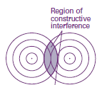
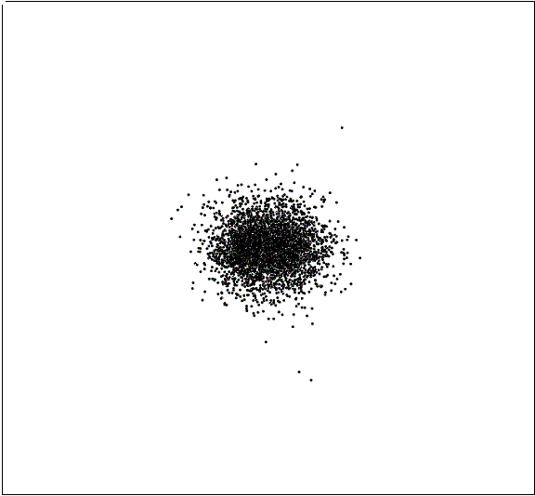
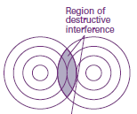
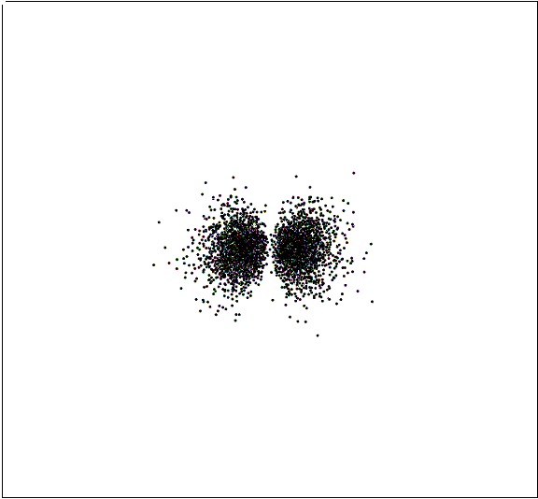
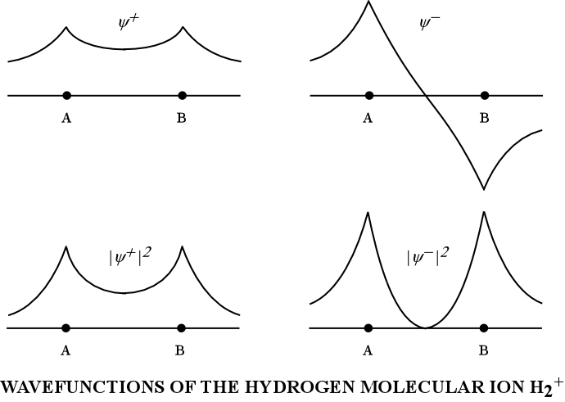
Molecular Orbital Theory of H₂⁺

Slide 10
Normalization
1
S
S : Overlap Integral

Slide 11
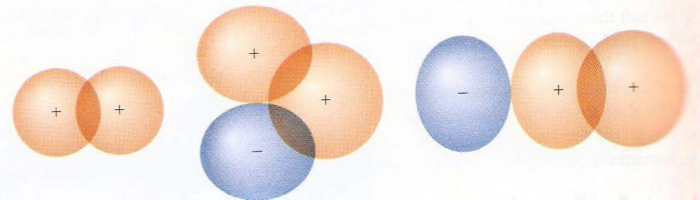
Overlap between orbitals
Overlap can be positive or negative or zero…..
….. and is a function of the internuclear separation R

Slide 12
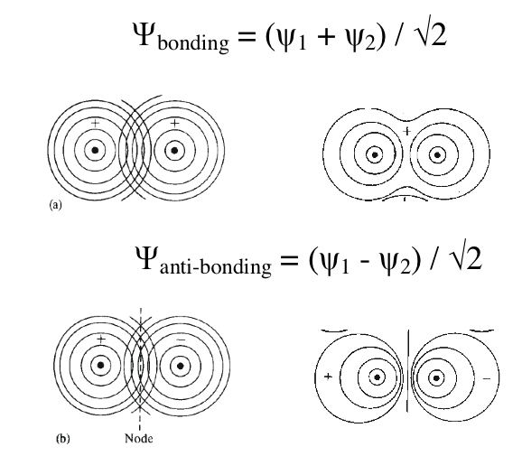
Molecular Orbital Theory of H₂⁺

Slide 13
Molecular Orbital Theory of H₂⁺
%

Slide 14
Molecular Orbital Theory of H₂⁺

Slide 15
Molecular Orbital Theory of H₂⁺

Slide 16
Molecular Orbital Theory of H₂⁺
Ĥ is Hermitian

Slide 17
Molecular Orbital Theory of H₂⁺

Slide 18
Molecular Orbital Theory of H₂⁺ : H_{ii}
Constant at fixed internuclear distance
J ⇒ Coulomb Integral

Slide 19
Molecular Orbital Theory of H₂⁺ : H_{ij}
Constant
//
//
//
//v
//v
//v
//v
//
//v
K is purely a quantum mechanical concept. There is no classical counterpart
K ⇒ Exchange Integral
Resonance Integral

Slide 20
Molecular Orbital Theory of H₂⁺

Slide 21
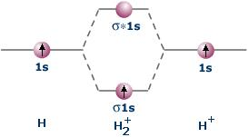
Molecular Orbital Theory of H₂⁺

Slide 22
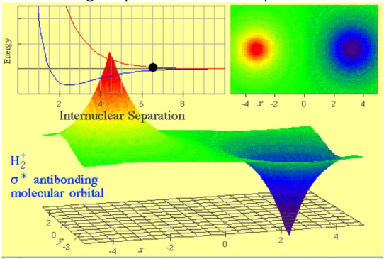
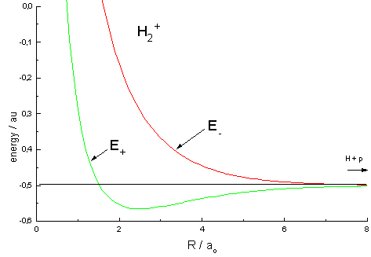
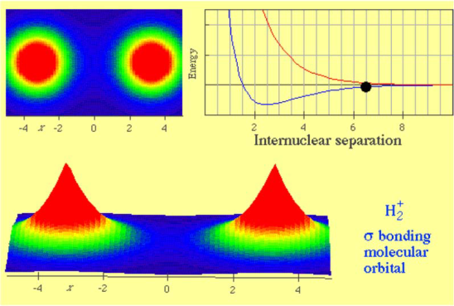
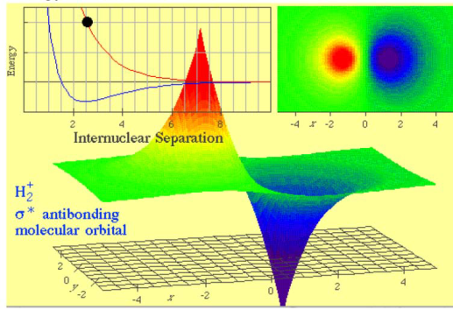
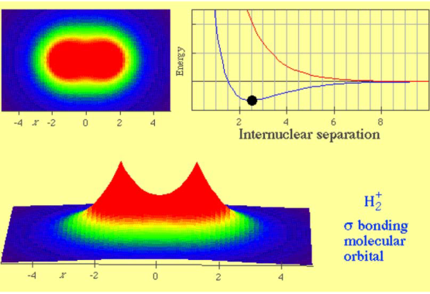
Molecular Orbital Theory of H₂⁺
E₂
1
E₁

Slide 23
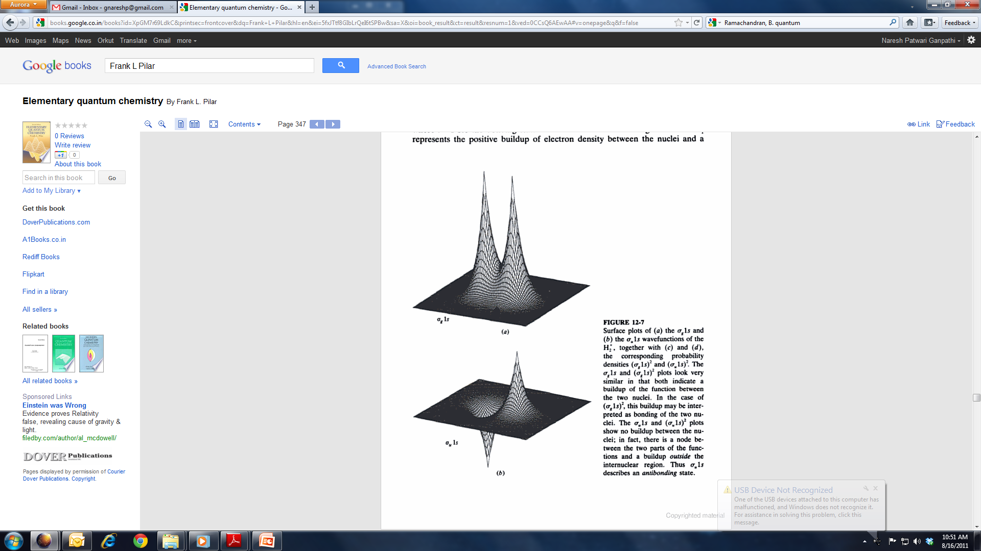
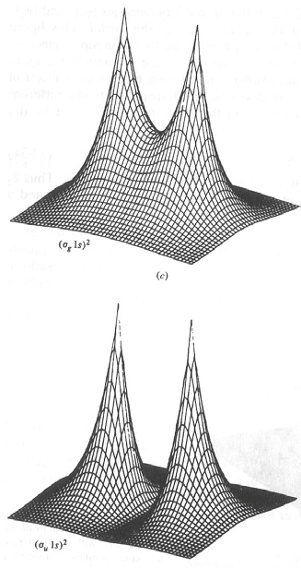
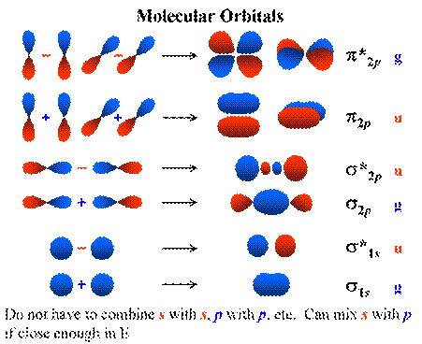
Sigma Bonding with 1s Orbitals

Slide 24
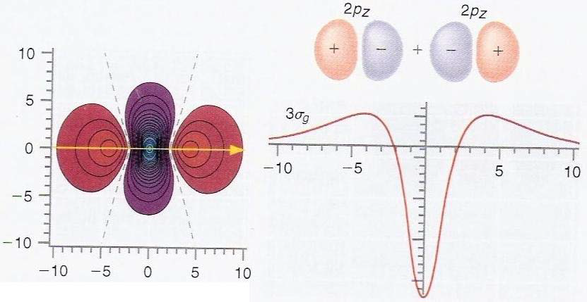
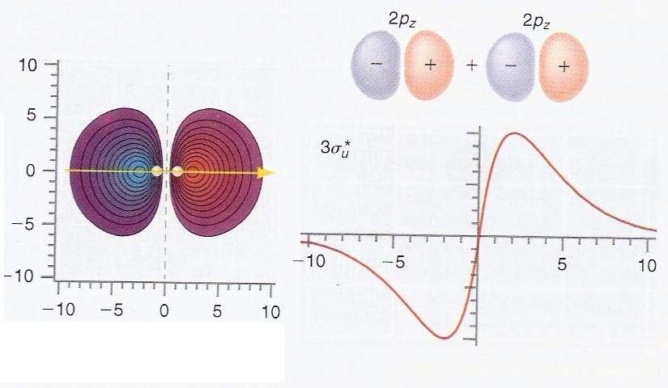
Sigma Bonding with 2p Orbitals

Slide 25
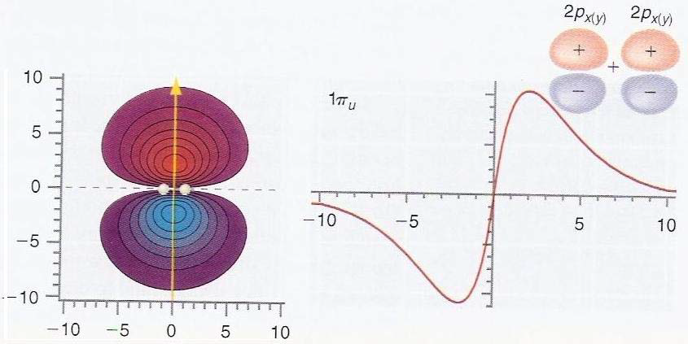
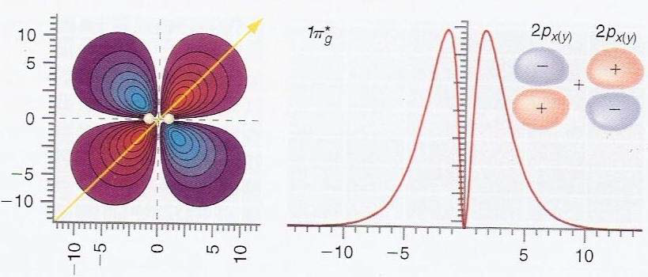
Pi Bonding with 2p Orbitals
Note the signs, symmetries and nodes

Slide 26
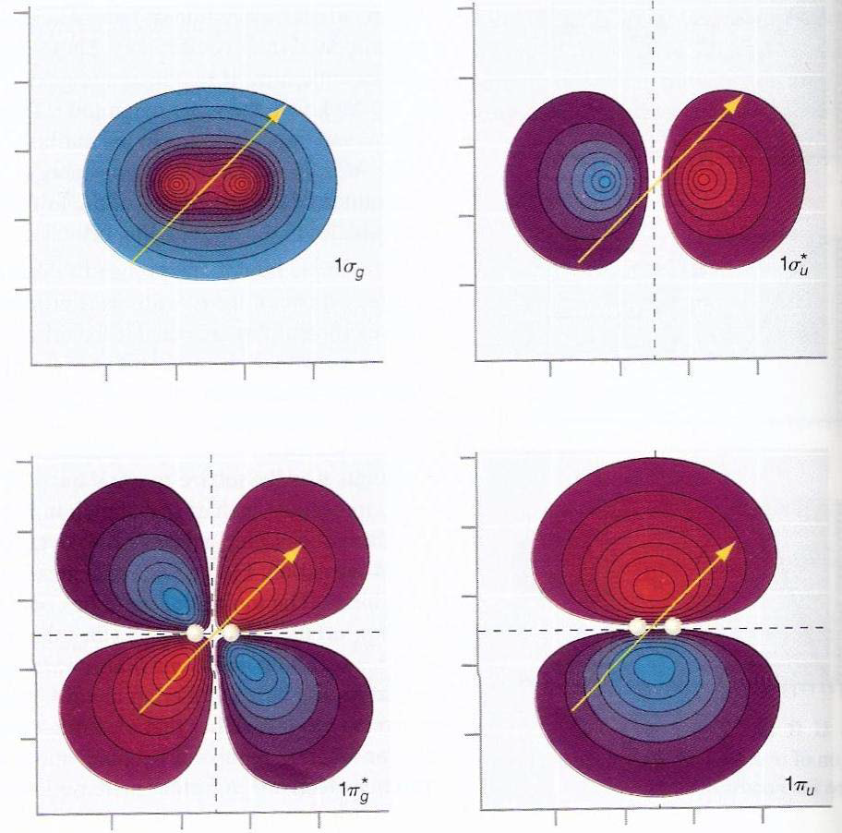
Symmetry of Orbitals
Hydrogen molecule ion:
Bonding: Symmetric
→ σ_{g}
Anti-bonding: Antisymmetric
→ σ_{u}
Gerade (g) → Symmetric
Ungarade (u) → Antisymmetric

Slide 27
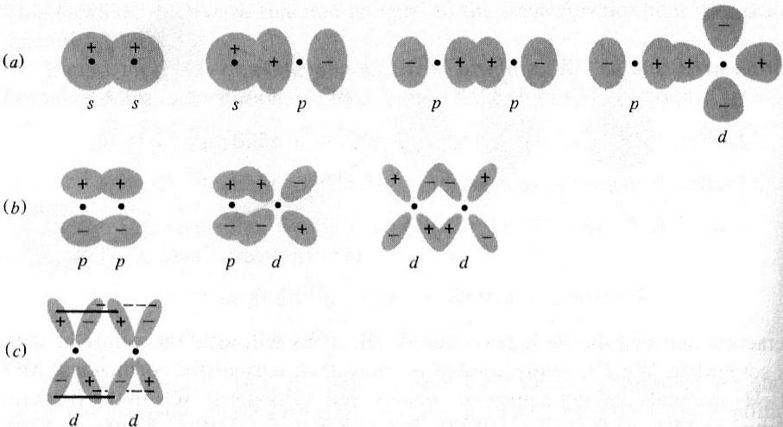
Types of Bonds

Slide 28
-
e⁻
Bonding: H₂ molecule
r_{1A}
r_{1B}
Born – Oppenheimer Approximation
r₁
H_{A}
+
+
H_{B}
r₂
R
r_{2A}
r_{2B}
e⁻
-
NOT a constant
CANNOT be Solved
For all the molecules except the simplest molecule H₂⁺ the Schrodinger equation cannot be solved.
We need methods to find approximate solutions

Slide 29
Valance Bond Theory
R= R_{e}
R=∞
Resonance
H−−H ←→ H⁺−−H⁻ ←→ H⁻ −−H⁺
Inclusion of Ionic terms

Slide 30
Valance Bond Theory
200
0
E (kJ mol⁻¹)
R= R_{e}
-200
-400
50
150
250
R (pm)
Type of wavefunction | E (kJ mol⁻¹) | R (pm)
Uncorrected Ψ=Ψ_{A}Ψ_{B} | 24 | 90.0
Heitler London | 303 | 86.9
Addition of shielding | 365 | 74.3
Addition of Ionic contributions | 388 | 74.9
Experimental values | 458 | 74.1

Slide 31
Molecular Orbital Theory of H₂
For H₂⁺
Place the second electron in the bonding orbital to get H₂ (ground state)

Slide 32
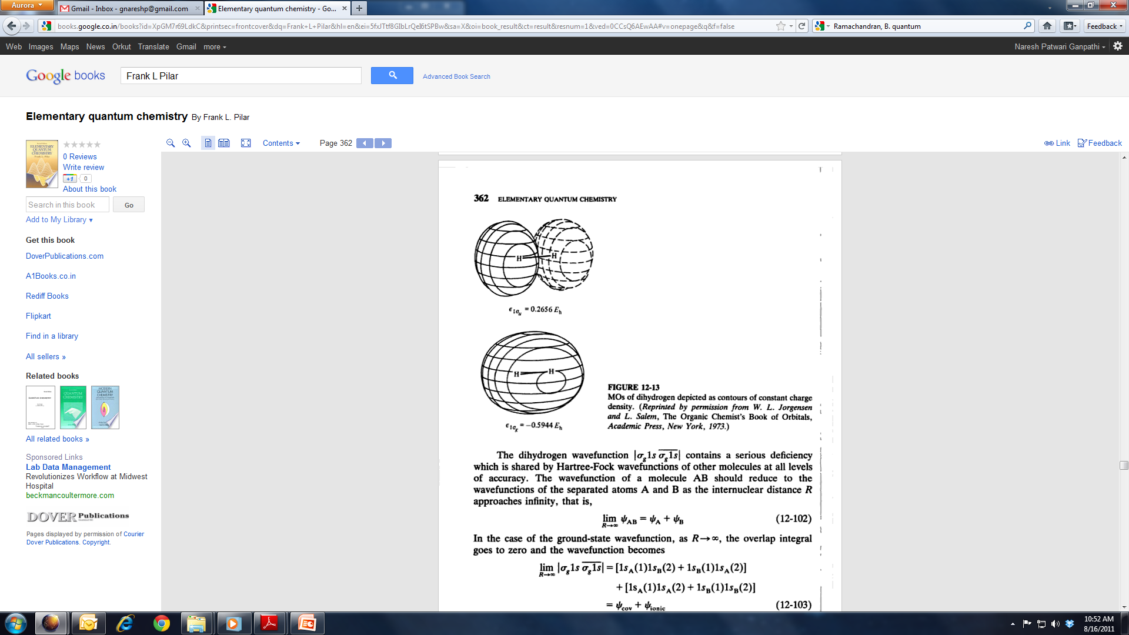
Molecular Orbital Theory of H₂
Spatial Part
Ionic terms: overemphasized

Slide 33
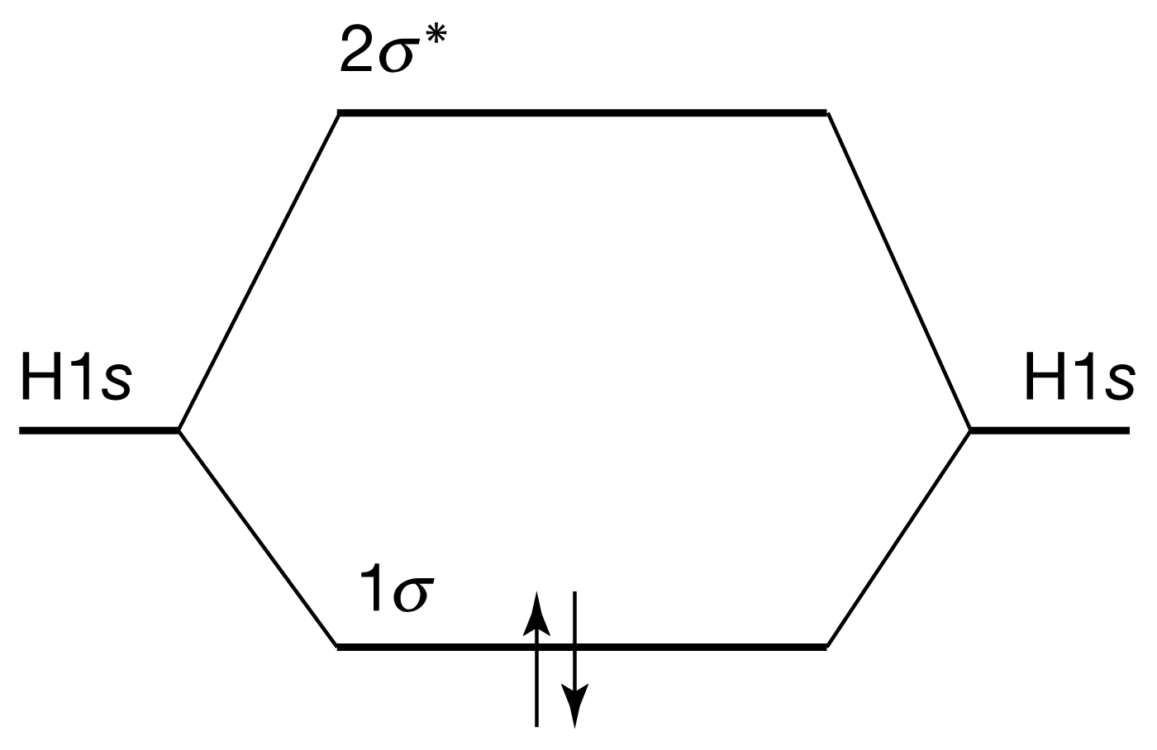
Molecular Orbital Theory of H₂

Slide 34
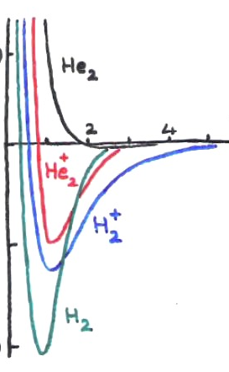
Diatoms of First Row: H₂⁺, H₂ ,He₂, He₂⁺
He₂
He₂⁺
H₂⁺
H₂
Species | No. of electrons | Electron confign. | Bond order | Bond length (pm) | Binding energy (kJ mol⁻¹
H₂⁺ | 1 | (1σ)¹ | 0.5 | 106 | 268
H₂ | 2 | (1σ)² | 1 | 74 | 457
He₂⁺ | 3 | (1σ)²(1σ∗)¹ | 0.5 | 108 | 241
He₂ | 4 | (1σ)²(1σ∗)² | 0 | 6000 | <<1

Slide 35
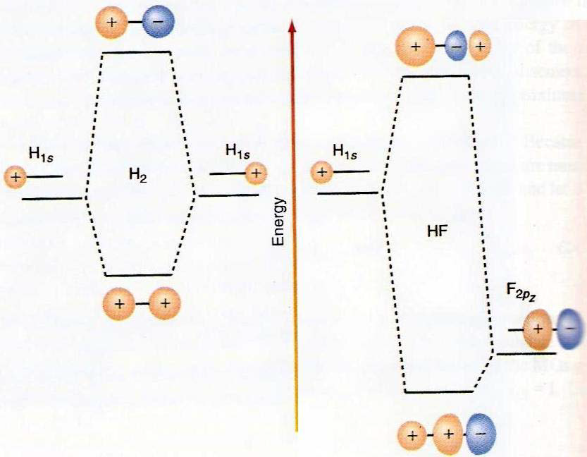
Matching of AO energies for MO
Both symmetry and energy
Matching is required for MO.
Valence electrons are most important
Due to large difference in energy of 1s(H) and 1s(F), LCAO-MO for both 1s is not feasible in HF.
Rather, 2p_{z}(F) and 1s(H) form a sigma bond.

Slide 36
Bonding in 2nd Row Homo-Diatomic Molecules
2p
2p
2s
2s
1s
1s
The orbital energies of the two approaching atoms are identical before they start interacting to form a BOND

Slide 37
Bonding in First-Row Homo-Diatomic Molecules
3σ*
2p
1π*
2p
1π
3σ
2σ*
2s
2s
2σ
1σ*
1s
1s
1σ
The interaction between the energy and symmetry matched orbitals leads to various types of BONDs

Slide 38
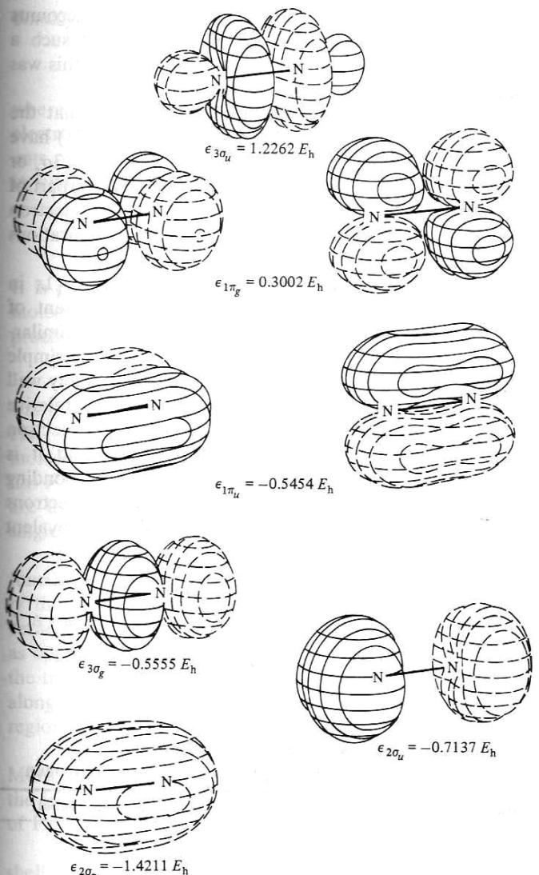
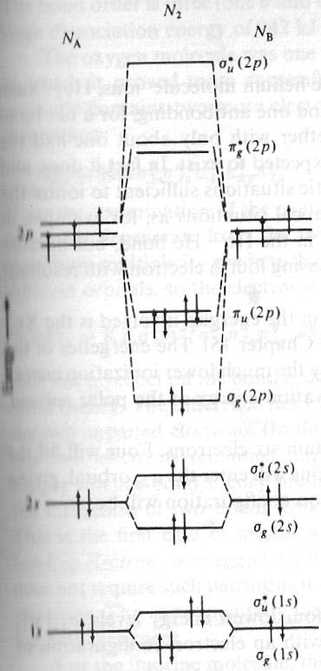
MO Energies of Dinitrogen
Experiments tell us this picture is incorrect!

Slide 39
Bonding in 2nd Row Homo-Diatomic Molecules
2p
2p
2s
2s
1s
1s
The 2s and 2p orbitals are degenerate in Hydrogen. However in the many electron atoms these two sets of orbitals are no longer degenerate.

Slide 40
Bonding in 2nd Row Homo-Diatomic Molecules
2p
2p
2s
2s
1s
1s
The difference in the energies of the 2s and 2p orbitals increases along the period. Its is minimum for Li and maximum for Ne

Slide 41
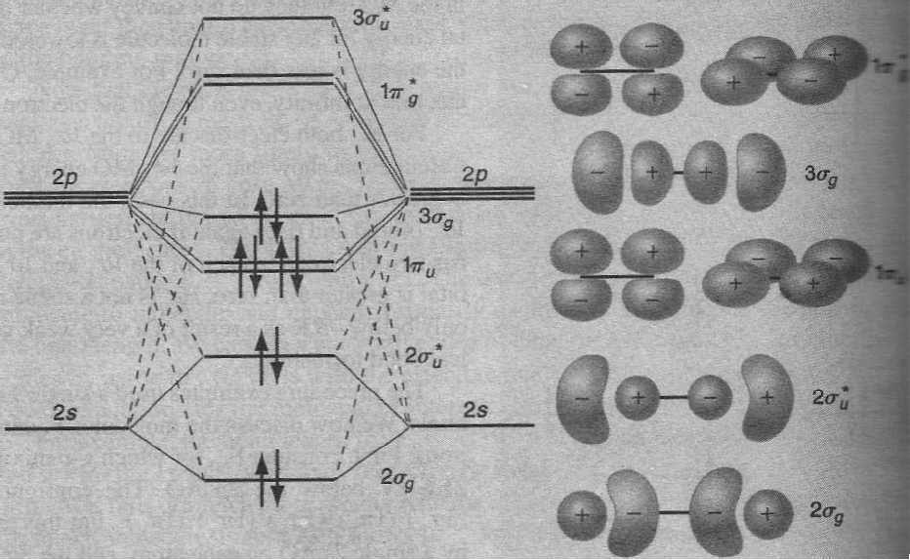
MO Energies of Dinitrogen
Mixing of 2s and 2p orbital occur because of small energy gap between them
2s and 2p electrons feels not so different nuclear charge.
Note how the MO of 2s→σ have p-type looks, while π-levels are clean

Slide 42
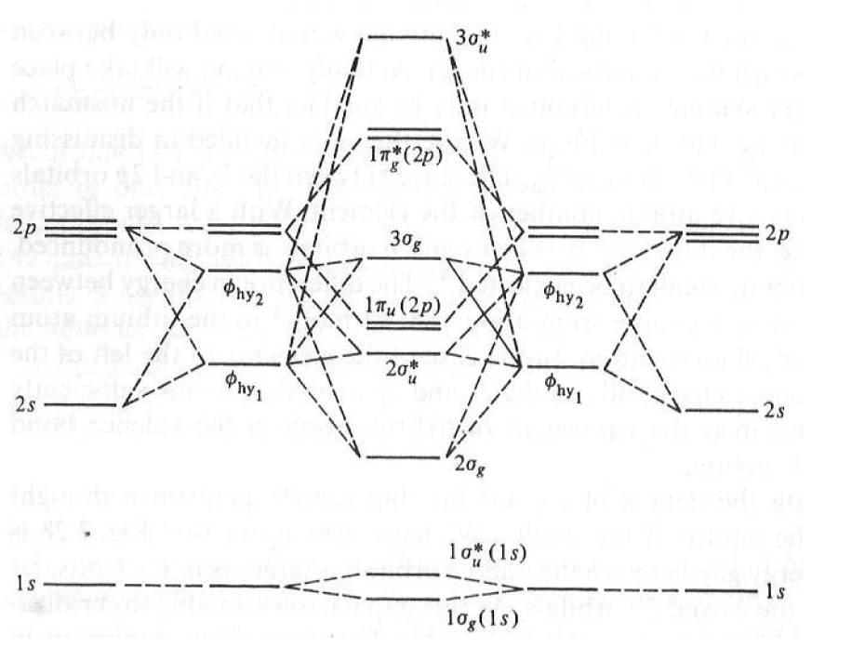
s-p Mixing: Hybridization of MO
Mixing of 2s and 2p orbital occur because of small energy gap between them 2s and 2p electrons feels not so different nuclear charge

Slide 43
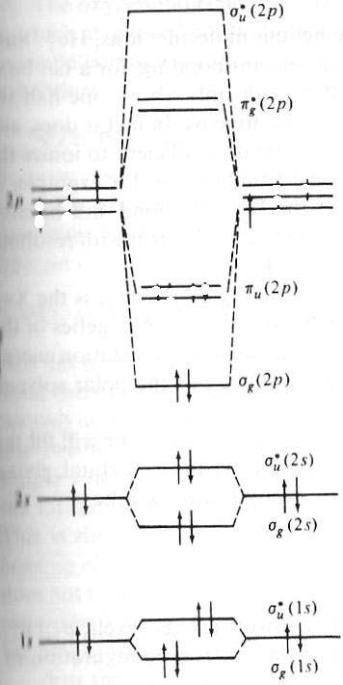
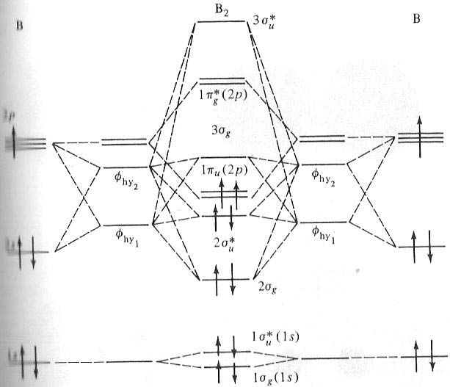
s-p Mixing: Hybridization of MO
Incorrect!
B₂ is paramagnetic. This can only happen if the two electrons with parallel spin are placed in the degenerate π-orbitals and if π orbitals are energetically lower than the σ orbital

Slide 44
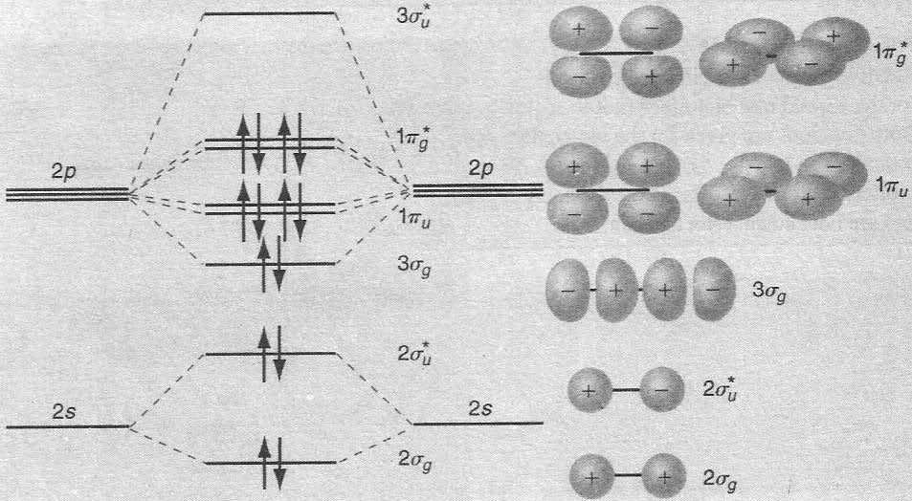
MO diagram of F₂: No s-p Mixing
No Mixing of s and p orbital because of higher energy
Gap between 2s and 2p levels in Oxygen and Fluorine!
2s and 2p electrons feels very different nuclear charge

Slide 45
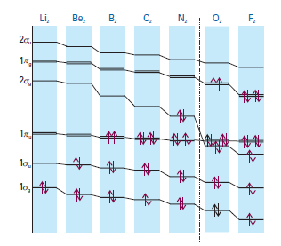
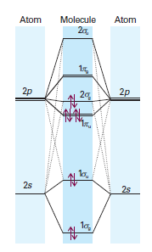
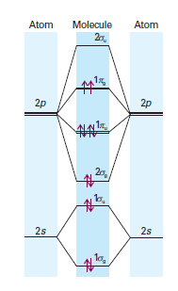
MO Energy Level Diagram for Homo-Diatomics
Upto N₂
Beyond N₂

